Slide 1

Engineering College & Placement Analytics Using Data-Driven Insights
Presented By:
M. Kushal Virendra Chowdary
Batch No: 436

Slide 2
About me
I am a recent B.Tech graduate in Artificial Intelligence and Data Science from Vignan Institute of Technology and Science.
As an AI & DS student, I have the passion and interest to learn Data Science and apply it to solve real-world problems
LinkedIn - https://linkedin.com/in/kushal-manduri
GitHub - https://github.com/kushal1989

Slide 3

Table of Contents
Business Problem statement
Project Objective
Introduction
Data Understanding
Data Cleaning Steps
Analysis
Hypothesis Testing
Conclusion
Recommendations
Q&A

Slide 4
Business Problem Statement
Ravi is a Class 12 student who wants to pursue engineering. He searches online and finds thousands of engineering colleges with different Tuition fees, Placement packages, Rankings, Locations & Student ratings
Students and parents face difficulty in selecting engineering colleges because:-
Fee structures vary widely
Placement outcomes are inconsistent
Rankings do not always reflect value for money

Slide 5
Project Objective
The objective of this project is to perform Exploratory Data Analysis (EDA) on engineering college data scraped from online platforms in order to:-
Analyze the relationship between fees and placement packages
Compare performance across locations and rankings
Highlight trends that help students choose colleges wisely

Slide 6
Introduction
The data was scraped from collegesearch.in, a web platform listing colleges in India.
Specifically, the engineering college listings were collected from:
https://www.collegesearch.in/engineering-colleges-india
This site provides information on engineering colleges, including:
                College name
                Location (state / city)
                Tuition fees
                Placement packages
                Ratings and reviews
                Entrance exams accepted
It is a useful resource for comparing and evaluating institutions across India.
The data obtained from this site formed the basis of the dataset used in this project.

Slide 7
Data Understanding
Column Name | Type | Description
college_name | Object | Name of the engineering college
rating | Float | Average student rating of the college
location | Object | State or city where the college is located
courses_offered | Object | Engineering courses offered by the college (e.g., B.Tech / B.E.)
tution_fee | Float | Tuition fee charged by the college in INR
exams_accepted | Object | Entrance examinations accepted for admission
highest_package | Float | Highest placement package offered by the college (in LPA)

Slide 8
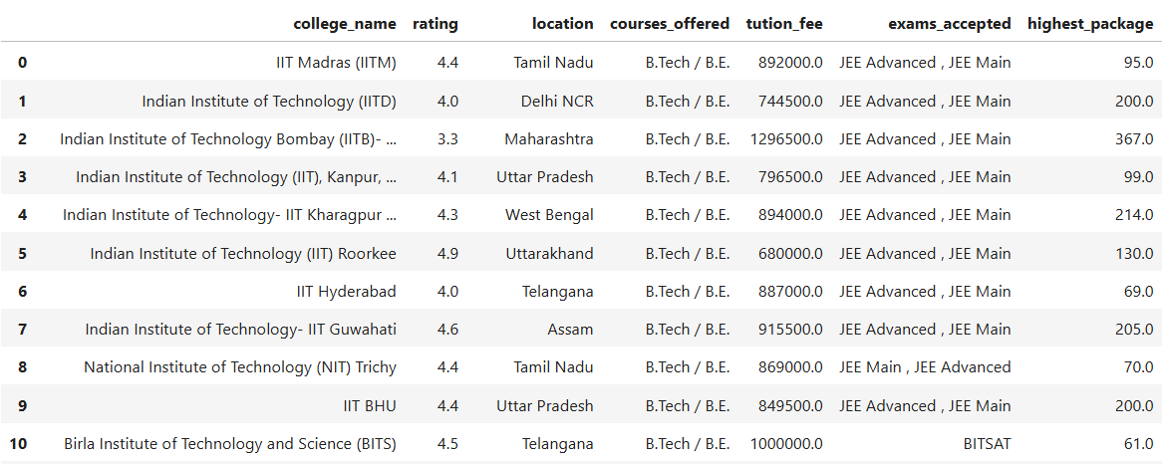
Data Scraped From Website

Slide 9
Data Cleaning Steps
Removed duplicate college records to avoid repeated analysis.
Handled missing values in tuition fee and highest package columns by converting unavailable entries (e.g., “Get Fee Details”, “-”) into null values.
Cleaned currency fields by:
      Removing symbols such as ₹ and commas
      Converting fees and packages into numeric format for analysis.
Cleaned location data by extracting only state names from mixed text entries.
Removed irrelevant text and noise from scraped data (e.g., “Official Admission Partner”, “View College”).

Slide 10
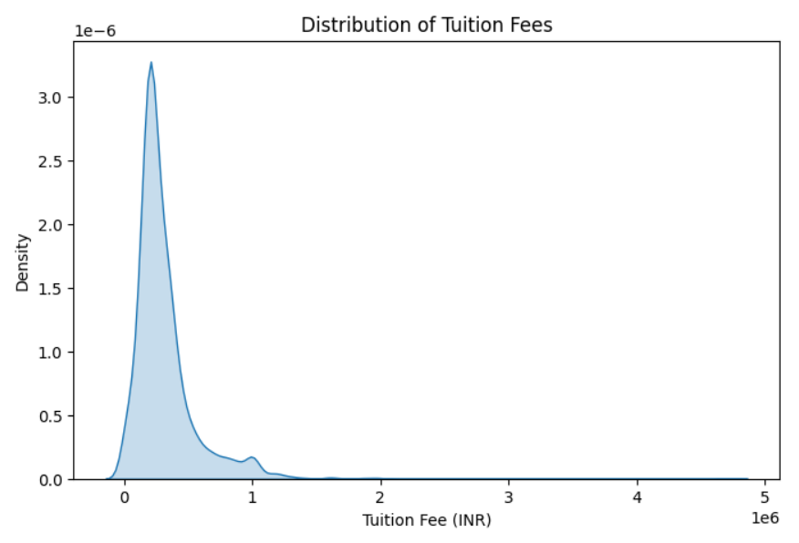
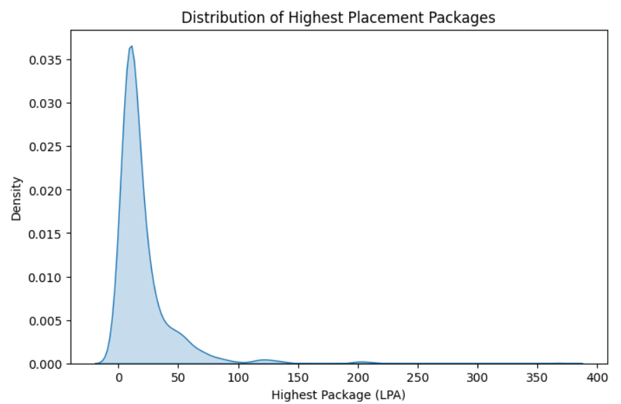
Uni Variate Analysis
Tuition fees are right-skewed, with most colleges charging low to moderate fees and only a few colleges demanding very high fees.
Highest packages are highly skewed, where most colleges offer average packages, while a small number of colleges report extremely high packages acting as outliers.

Slide 11
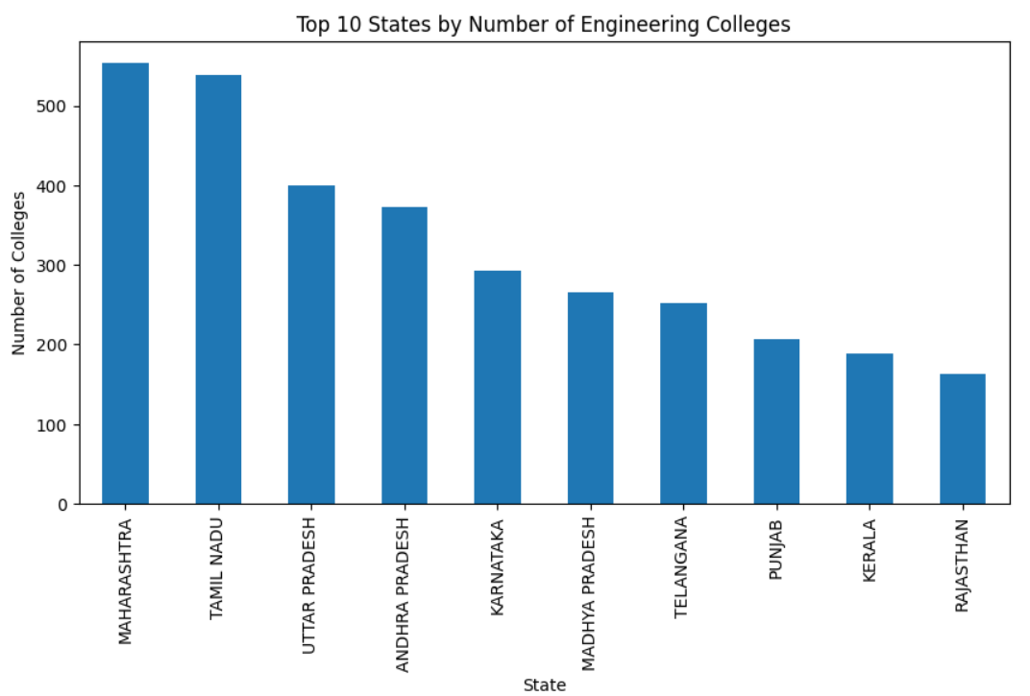
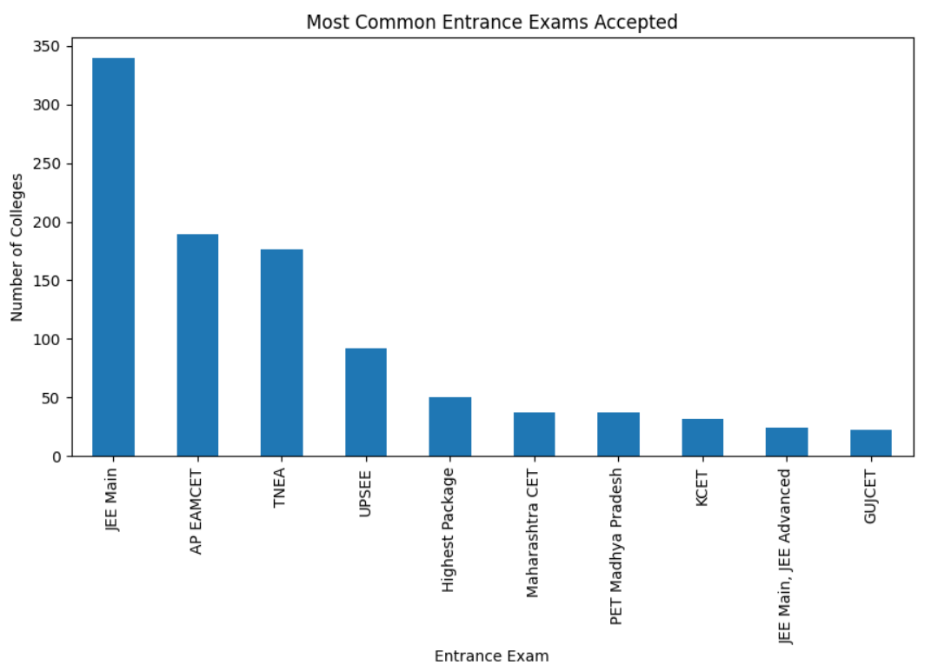
Engineering colleges are highly concentrated in a few states, with Maharashtra and Tamil Nadu leading significantly over others.
JEE Main dominates as the primary entrance exam, followed by major state-level exams, indicating a centralized admission pattern.

Slide 12
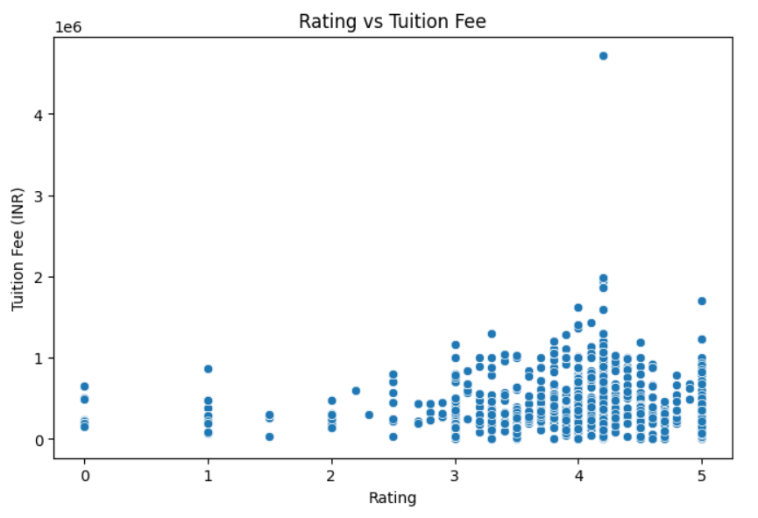
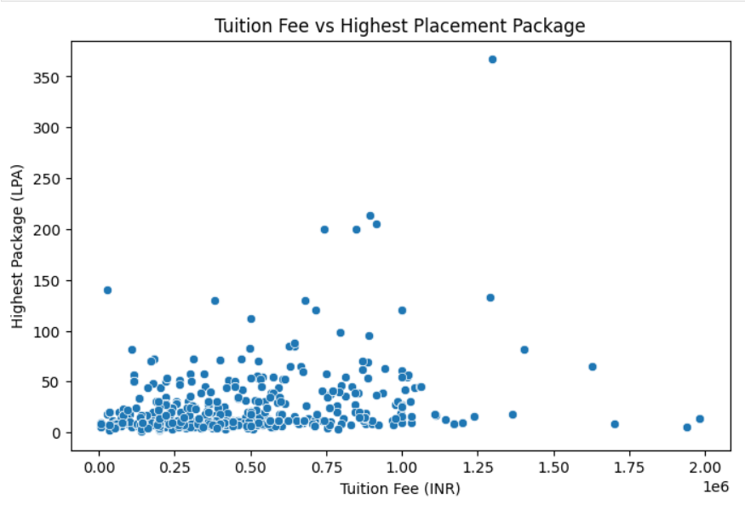
Bi Variate Analysis
Higher-rated colleges do not consistently charge higher fees, indicating that ratings alone are not a strong driver of tuition cost.
Paying higher tuition fees does not guarantee higher placement packages, as most high packages occur across a wide fee range.

Slide 13
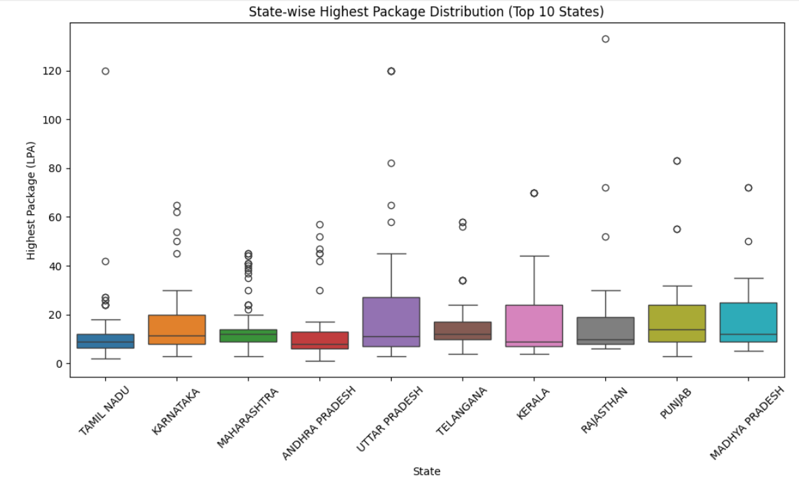
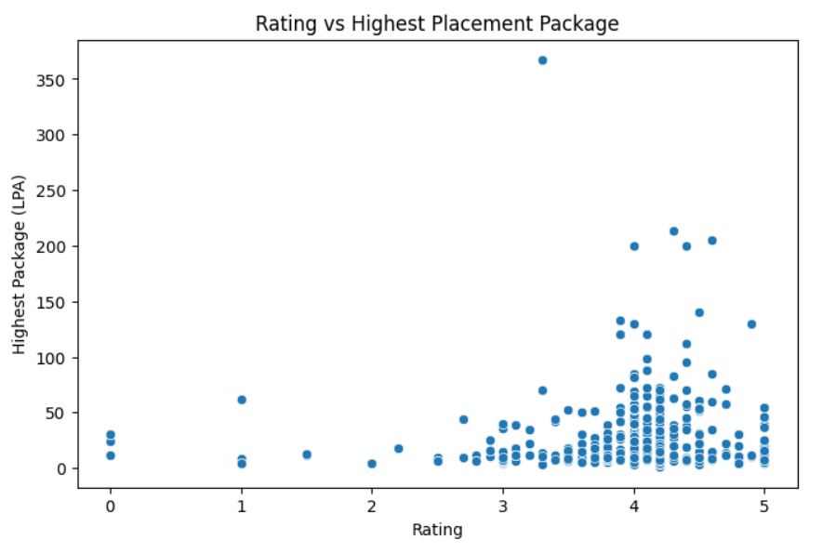
States show wide variation in placement packages, with a few colleges in each state offering very high packages while most provide moderate outcomes.
Higher-rated colleges tend to have better placement potential, but high packages are not guaranteed by ratings alone, indicating weak-to-moderate correlation.

Slide 14
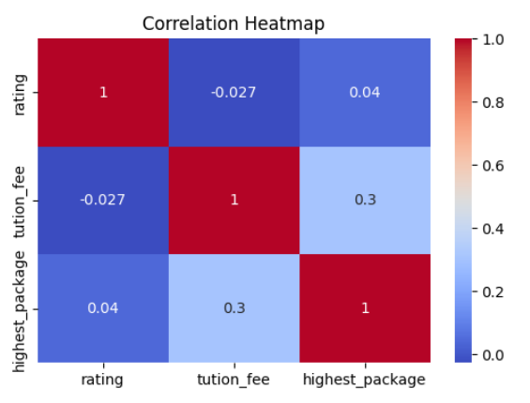
Multi Variate Analysis
Tuition Fee vs Highest Package (≈ 0.30) - Shows a moderate positive correlation. Colleges with higher fees tend to offer higher placement packages, but the relationship is not strong.
Rating vs Tuition Fee (≈ -0.03) - Almost no correlation. Higher-rated colleges do not necessarily charge higher fees.
Rating vs Highest Package (≈ 0.04) - Very weak correlation. College ratings do not reliably indicate better placement outcomes.

Slide 15
Hypothesis Testing
Hypotheses 1:
H₀ : Tuition fee has no impact on highest placement package
H₁ : Higher tuition fee significantly affects placement package
Result:
p-value = 5.01 × 10⁻⁹
Decision: Reject H₀
Tuition fee significantly affects placement, but higher fees do not always guarantee proportionally higher packages.
Hypotheses 2:
H₀: College rating does not affect placement outcomes
H₁: Higher-rated colleges give better placements
Result:
p-value = 0.565
Decision: Fail to reject H₀
Top-rated colleges do not always provide better placement outcomes.

Slide 16
Hypotheses 3:
H₀: Location has no impact on placement
H₁: Placement varies by location
Result:
p-value = 0.003
Decision: Reject H₀
Placement outcomes vary significantly across states.
Hypotheses 4:
H₀: Affordable colleges do not offer strong placements
H₁: Affordable colleges can offer strong placements
Result:
p-value = 7.06 × 10⁻⁵
Decision: Reject H₀
Affordable colleges CAN deliver strong placement outcomes.

Slide 17
Conclusion
Tuition fee and placement show only a weak relationship
High fees do not guarantee better placements
College ratings have minimal impact on real outcomes
Location matters for availability, not guaranteed success
Recommendations
Prefer mid-range tuition fee colleges
Do not chase extreme placement numbers
Compare fees vs realistic placement outcomes
Do not consider rankings alone, for decision-making

Slide 18


Slide 19

THANK YOU

